Slide 1

Image Scraping and Classification Project
Submitted by: SONALI WARKHADE

Slide 2
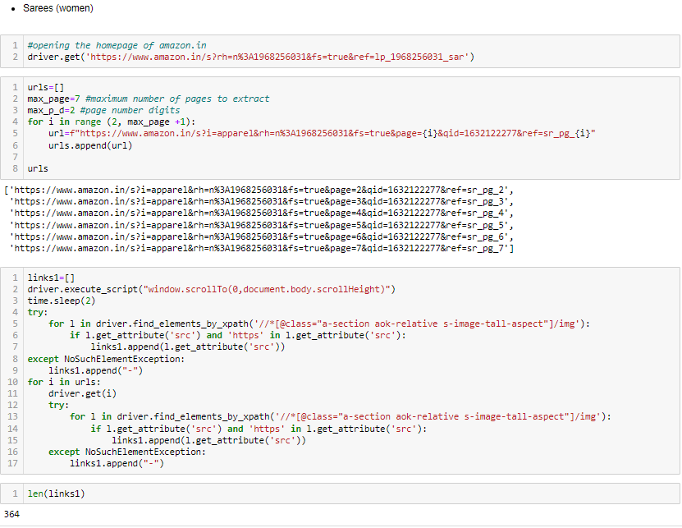
Scraping Images:

Slide 3
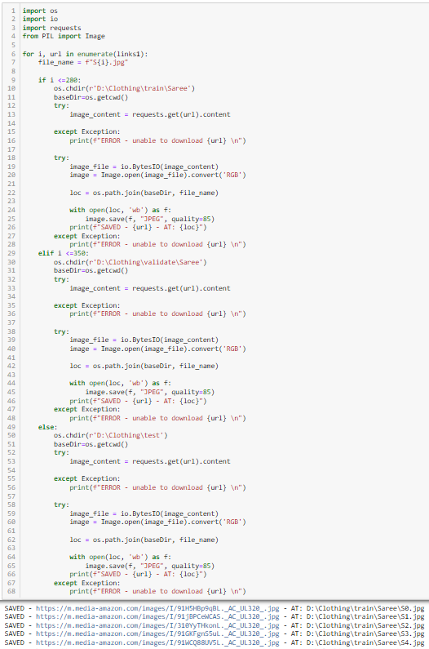

Slide 4
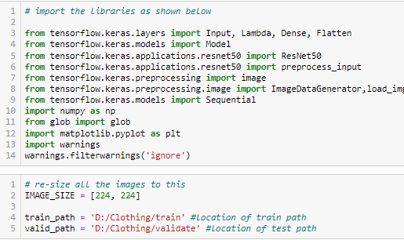
Importing required libraries and databases

Slide 5

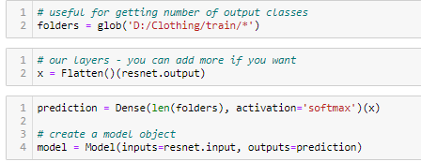
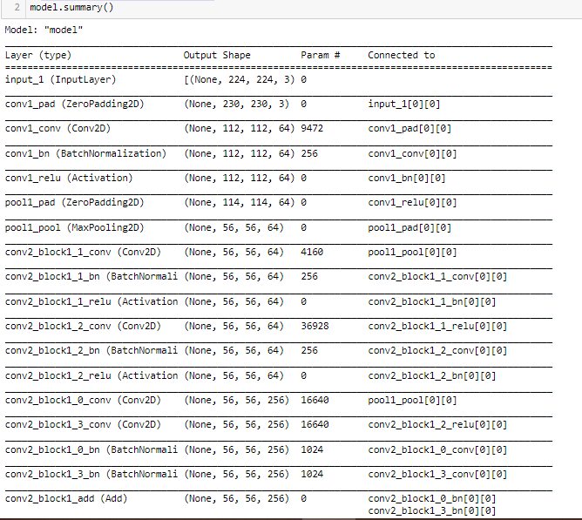
Import the library as shown below and add pre-processing layer to the front. Here we will be using ImageNet weights.
Let’s view the structure of the model:

Slide 6

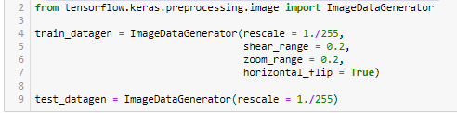
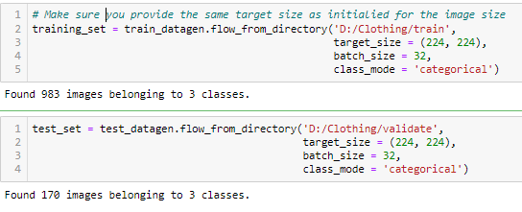
Lets specify cost and optimization methods to use:
I have used the Image Data Generator to import the images from the dataset.

Slide 7
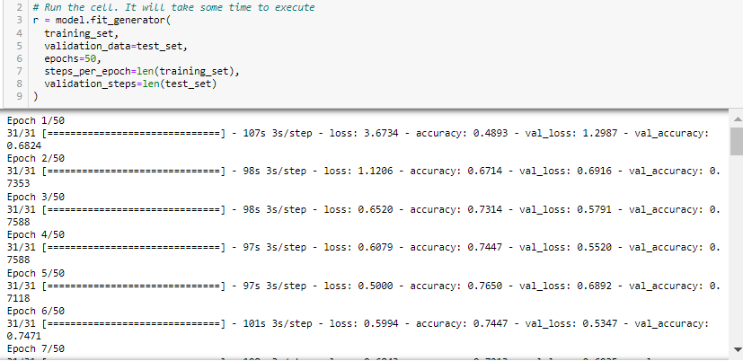
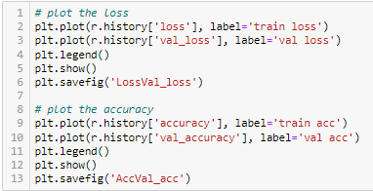
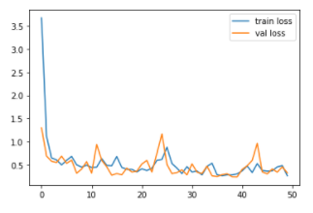
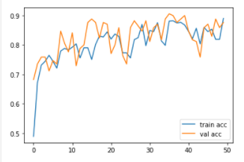
Let’s fit the model:
Let’s have a view at accuracy and loss with the help of graph:

Slide 8

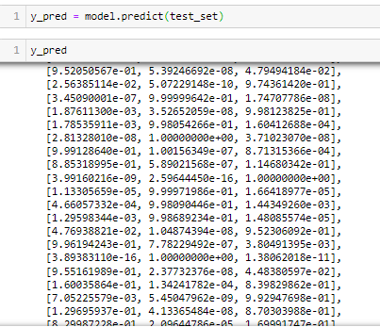
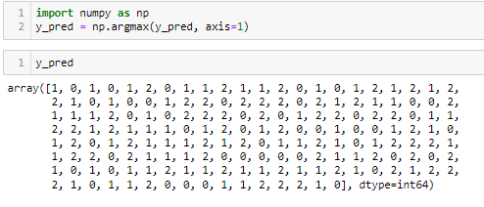
I have saved the model with the help of h5 file.
With the help of saved model lets predict the data for test set:
I have used Numpy library to make the prediction readable

Slide 9
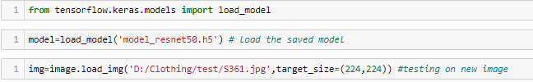
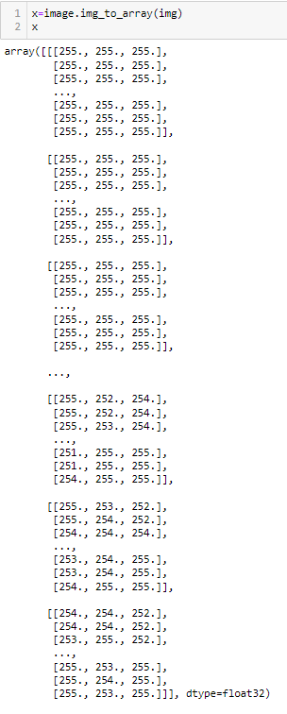

Slide 10
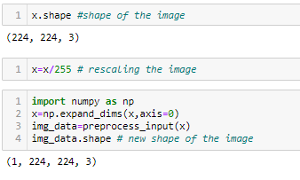
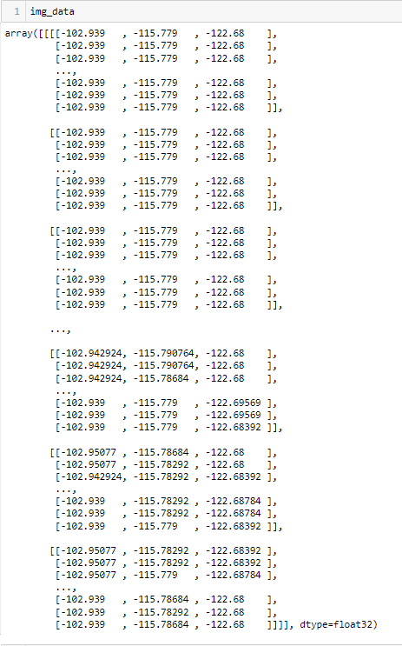

Slide 11
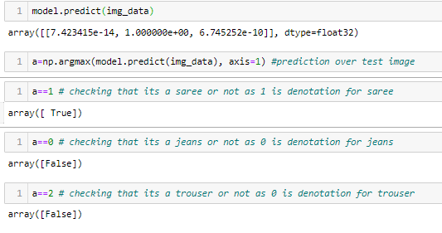
Predict the output:

Slide 12
Thank you ☺

